Slide 1
Discussion today
Using Lumerical INTERCONNECT we will simulate a full 50Gbps (25Gbps X 2) 2-channel WDM optical link.
Today we will look at the following:
Discuss ring resonator in INTERCONNECT
Import MODE results of effective index as a function carrier density into INTERCONNECT
Design and draw schematic of WDM optical link
Analyze results using eye-diagram

Slide 2
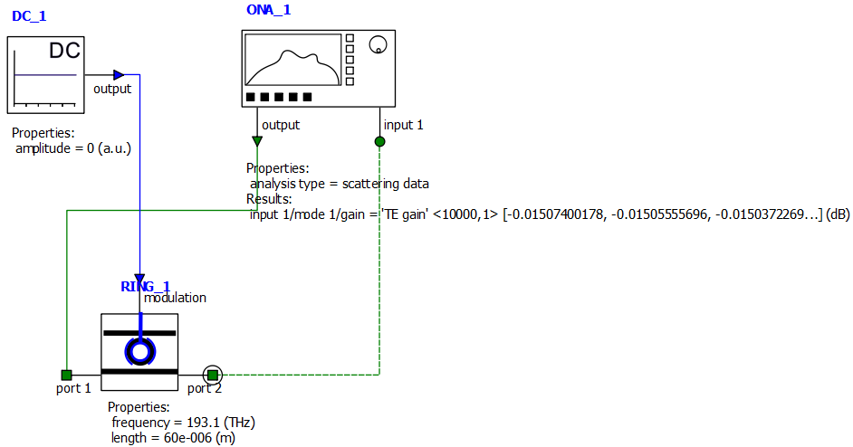
Analyzing ring resonator modulator in INTERCONNECT
Create the following circuit in INTERCONNECT consisting of
DC source (Sources->Electrical->DC Source)
Optical Network Analyzer (Analyzers->Optical->Optical Network Analyzer)
Ring Modulator (Modulators->Optical->Optical Ring Modulator)
Click and drag to draw connections

Slide 3
Ring resonator modulator model in INTERCONNECT
Select ring resonator object and change in Property View:
Standard->
Specify resonance frequency of 193.1 THz
Specify resonator length of 60e-6 m
Set load from file to True
Select measurement filename and set to mod_neff_V.dat (data of $Δn_{eff}$ vs. V - created in MODE last time)
Waveguide->
Specify group index 2.57 (from MODE)
Set loss to 7 dB/m (from last time we had ~0.07 dB/cm loss in simulation)
Set effective index to 0 (think of this as change in effective index)
Set coupling coefficient 1 and 2 to 0.025

Slide 4
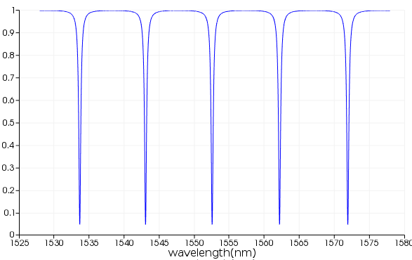
Ring resonator modulator model in INTERCONNECT
The ring resonator modulator model in INTERCONNECT is not documented very well.
The resonator length and group index is used to set the free spectral range (FSR) and loss of the ring resonator but not used to set the absolute resonance frequencies.
Instead we explicitly state what the resonance frequency should be.
$$FSR=\frac{λ^{2}}{n_{g}L}$$
(recall $Δf=\frac{c}{n_{g}L}$, and $\frac{Δf}{f}=\frac{Δλ}{λ}$)
FSR
$$n_{g}=n_{eff}+f_{0}\frac{∂n_{eff}}{∂f}$$
(proof: take $d/dk$ of $k=\frac{ω}{c}n_{eff}(ω)$)

Slide 5
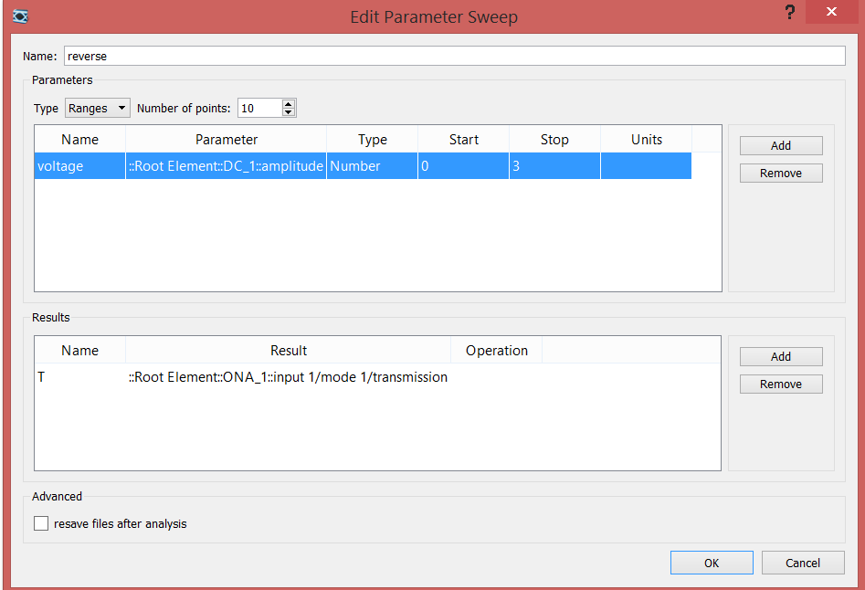
Effect of voltage on transmission spectrum
Run simulation to populate Result View
Create a sweep to vary the reverse bias voltage between 0 and 3V
Run sweep.
Plot Transmission data (Right-click sweep, Visualize->T)

Slide 6
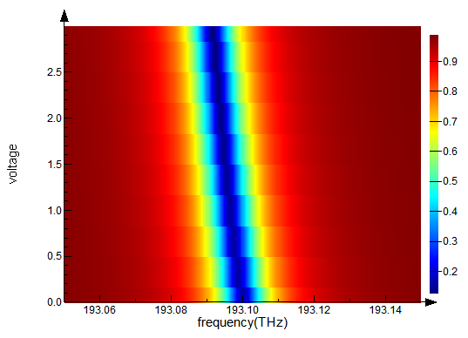
Effect of voltage on transmission spectrum
With applied voltage, the transmission dip shifts away from the center frequency

Slide 7
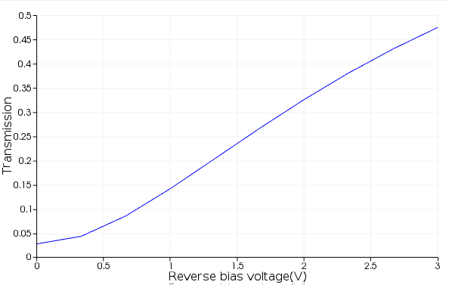
Effect of voltage on transmission spectrum
Open the script plot_ring_modulator_data.lsf to plot the transmission at the center frequency as a function of applied voltage.

Slide 8
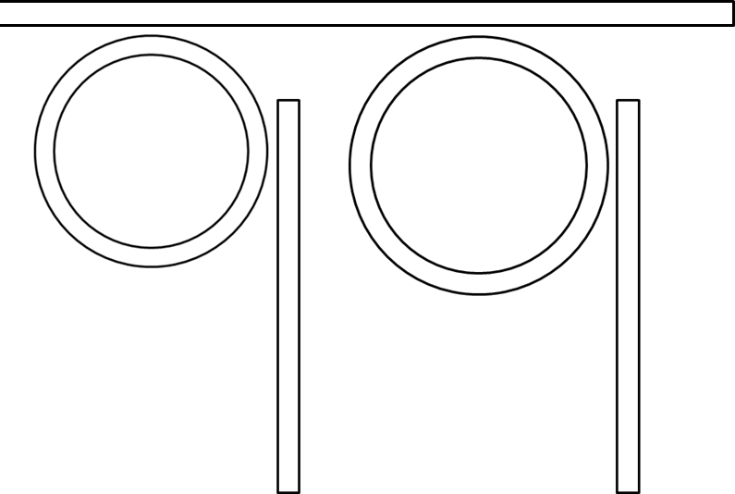
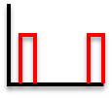
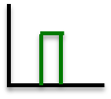
50GBps (2x25GBps) 2-channel WDM
Transmitter
fiber
Receiver
$$λ_{1}$$
$$λ_{2}$$
$$λ_{1}$$
$$λ_{2}$$
CW lasers
$$λ_{1}$$
$$λ_{2}$$
Data in (25GBps per channel)
Det.
Det.
Data out
$λ_{1}$=1552.8 nm
(200 GHz channel spacing)
$λ_{2}$= 1551.2 nm

Slide 9
50GBps (2x25GBps) 2-channel WDM
Open the INTERCONNECT file 2_channel_WDM.icp
This schematic contains a full 2-channel optical link consisting of 2 ring resonator modulators at the transmitter and 2 ring resonator filters at the receiver.

Slide 10
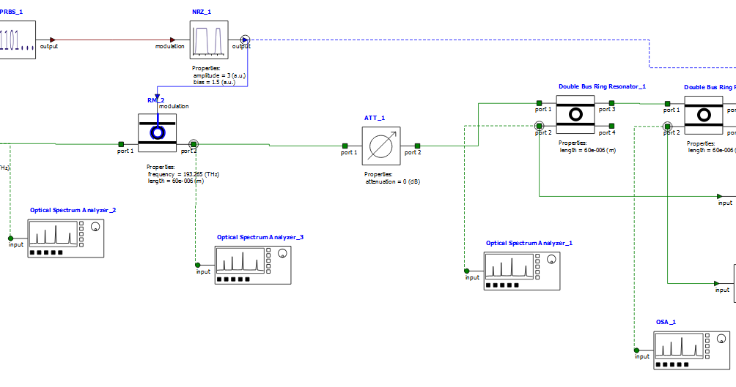
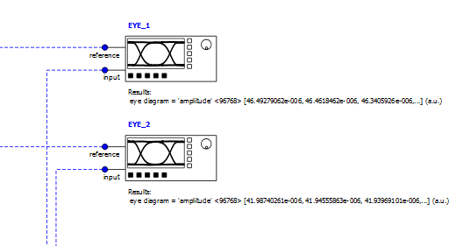
50GBps (2x25GBps) 2-channel WDM
Click Run and plot the power at the Optical Spectrum Analyzer after each ring resonator modulator (select object, in Result View right click and Visualize mode 1->signal)
Also plot the result of the eye diagrams monitors.

Slide 11
Non-return to zero (NRZ) vs. return to zero (RZ)
RZ signal
Time
NRZ signal
0
1
0
1
1
Time

Slide 12
Non-return to zero (NRZ) vs. return to zero (RZ)
RZ requires twice as much bandwidth as NRZ
One advantage of RZ is less interference between successive pulses
http://www.keysight.com/upload/cmc_upload/All/SLDPRE_6_Return_Zero_Methodo.pdf

Slide 13
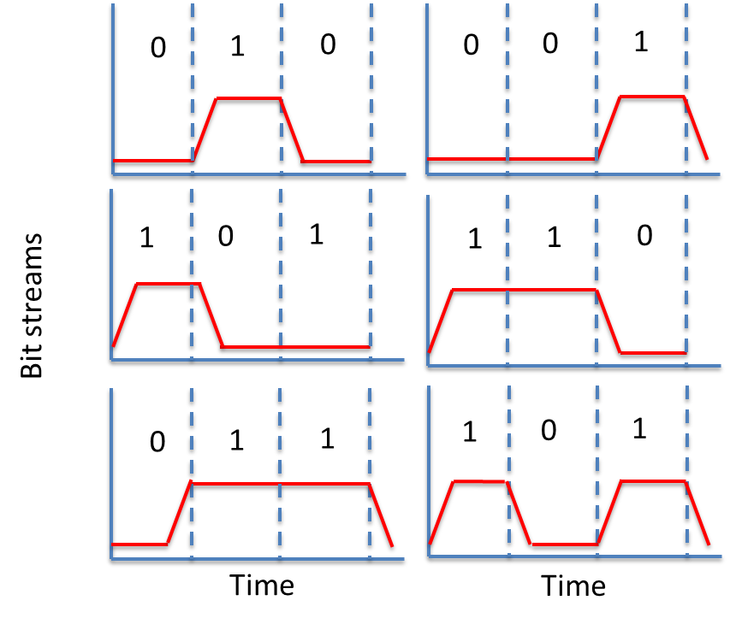
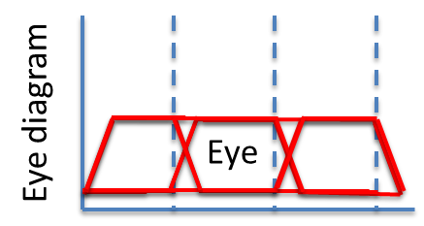
Eye diagram
Superimpose the oscilloscope trace of many different bit streams on top of each other. If there is good margin between “1” and “0” you should see something like a human eye.
etc.

Slide 14
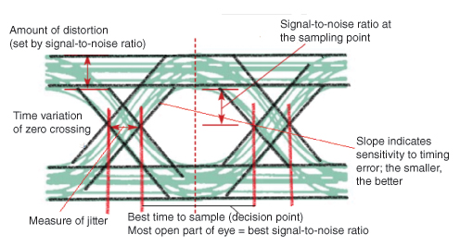
Eye diagram
Source: edn.com

Slide 15
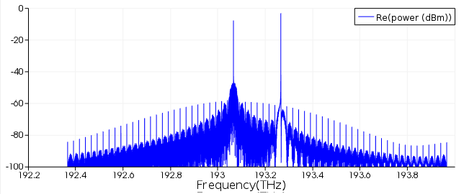
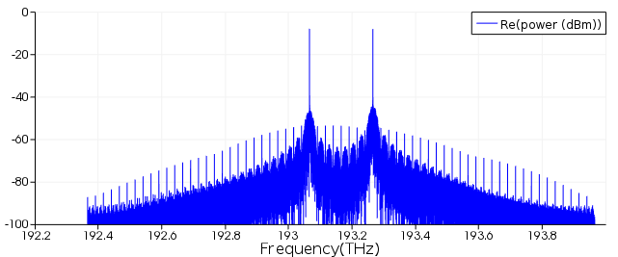
After 193.065 THz modulator
After 193.265 THz modulator

Slide 16
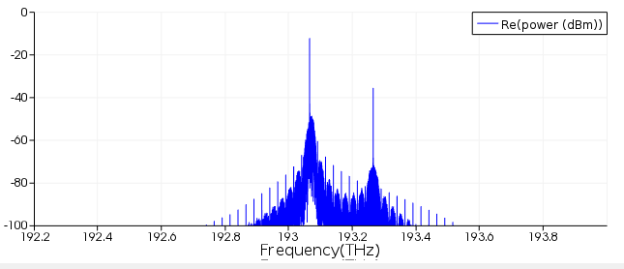
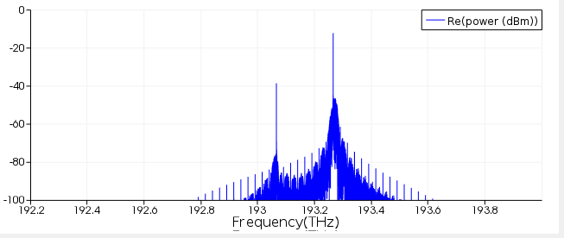
After 193.065 THz filter
After 193.265 THz filter

Slide 17
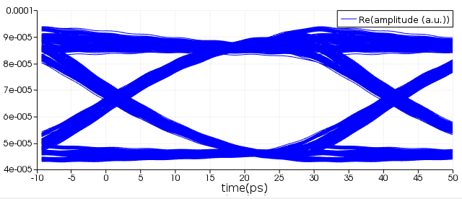
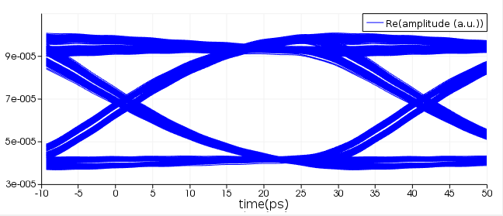
193.065 THz eye
193.265 THz
eye

